Slide 1

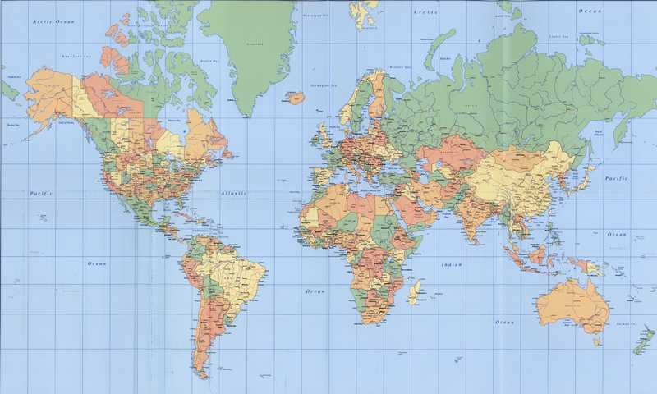
Citizenship in the World
By Tom Bougan. Based on deck by the
Gilbert Constitution Week Committee
www.constitutionweek.com

Slide 2
Requirement 1
Explain what citizenship in the world means to you and what you think it takes to be a good world citizen.
  Being a good world citizen means respecting the rights of other governments and people in other nations ... As world citizens and Americans, we must use our unique civic experience to seek and create democratic answers to global questions.
  World citizenship affects not only a country‘s relationship to other countries, but also its citizen's relationship to one another.
Citizen vs. subject?

Slide 3
2. How to become a US Citizen
Citizenship by
  Blood– You are a citizen by being born to parents who are citizens.
  Soil– You become a citizen because you were born in this country.
  Naturalization - persons may acquire the citizenship of a country.
    18 years old or older.
    Good Moral Character
    English & Civics Knowledge
    Attachment to the Constitution
    There are several options, such as:
      Legally come into and live in the United States for 5 years
      Serve in the military during a war
      Marry a US Citizen

Slide 4

Rights of a US Citizen
Where are our rights listed?
Does it give us those rights?
Freedom of Religion, Speech, Press, Peaceable Assemble
Right to Keep and Bear Arms
Protection from Unreasonable search and seizure
Right to a Speedy & Public Trail
Trial by Jury (Jury Nullification)
Amendment X: The powers not delegated to the United States by the Constitution, nor prohibited by it to the states, are reserved to the states respectively, or to the people.

Slide 5
Duties & Obligations
Obey Laws
Pay Taxes
Jury Duty
Serve as a Witness
Register for the Draft
Vote
Defend Your Country
Preserve and Protect the Constitution
Understand Your Country's History and Government
Be a Productive Member of Society
"Lethargy [is] the forerunner of death to the public liberty." --Thomas Jefferson

Slide 6
Requirement 2 (cont)
Discuss the similarities and differences between the rights, duties, and obligations of U.S. citizens and the citizens of two other countries

Slide 7


Do citizens in all countries have the same rights and responsibilities?

Slide 8


In most countries, a
CONSTITUTION
is the basic document of citizenship.
What is a constitution?

Slide 9

A constitution…
✓
Tells what a country’s values are
✓
Tells how a country’s government operates
✓
Tells what rights and responsibilities a country’s citizens have

Slide 10
Let’s see how constitutions from some other countries compare to ours…

Slide 11
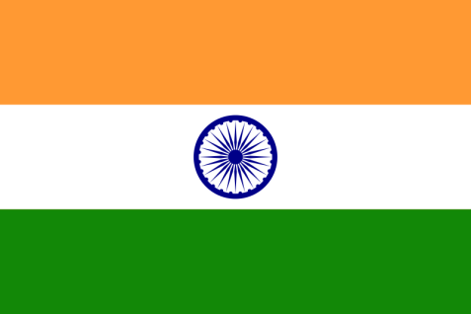
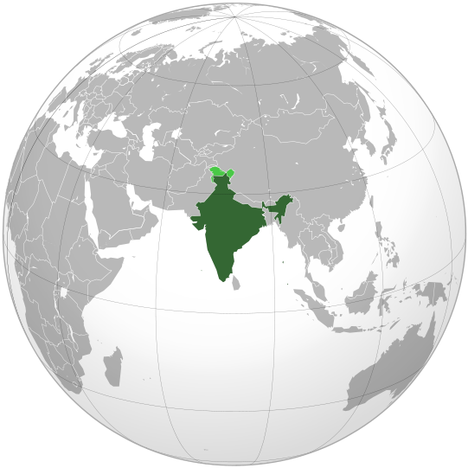
India
Introducing…
Region:
Asia
Capital City:
New Delhi
Language:
Hindi & English
Population:
1.28 billion
Area:
1.27 million sq miles

Slide 12
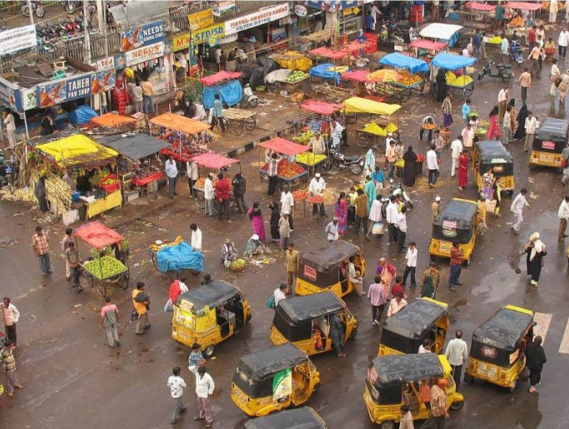
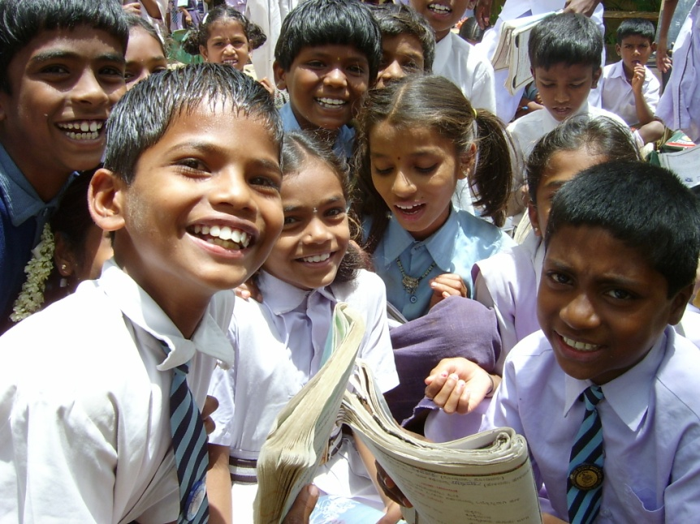
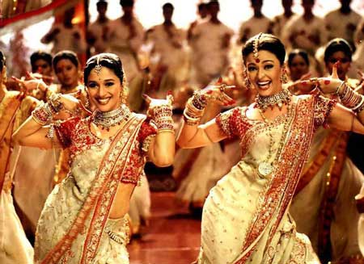
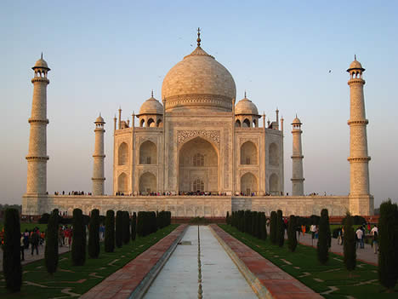
Street View
Indian Students
Performers in traditional Indian dress
An old palace known as the Taj Mahal

Slide 13
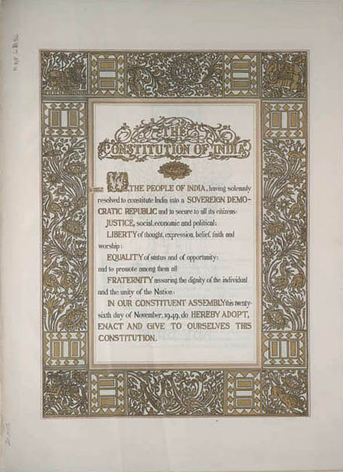
India
India has one of the longest constitutions in the modern world.
This is only the Preamble! There are 444 articles in the Constitution of India!

Slide 14
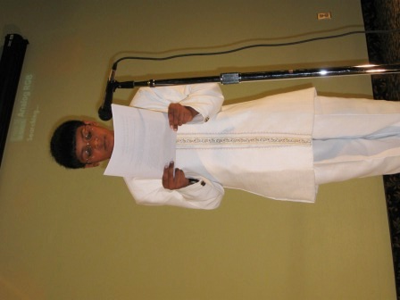
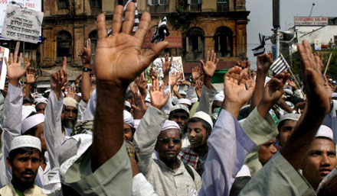
India
It lays out specific rights, much like the U.S. Constitution.

Slide 15


COMPARE IT!
Freedom of Speech
The United States Constitution says:
“Congress shall make no law…abridging the freedom of speech…”
India’s Constitution says:
“All citizens shall have the right to freedom of speech and expression;
Nothing…shall…prevent the State from making any law [that] imposes reasonable restrictions on [this right] in the interests of the sovereignty and integrity of India, the security of the State, friendly relations with foreign States, [or] public order, decency, or morality…”
Notes:
Instead of saying there should be NO law against freedom of speech, India’s constitution says that the government may pass a “reasonable” law against freedom of speech for several different reasons such as security, sovereignty, public order, decency, etc.

Slide 16

COMPARE IT!
Freedom of the Press
The United States Constitution says:
“Congress shall make no law…abridging the freedom.. of the press…”
India’s Constitution says:
“All citizens shall have the right to freedom of speech and expression…”
⇨
There is no separate “freedom of the press” in India’s constitution.
⇨
“Freedom of speech” works double duty!

Slide 17
COMPARE IT!
Freedom of Religion
The United States Constitution says:
“Congress shall make no law respecting an establishment of religion, or prohibiting the free exercise thereof…”
India’s Constitution says:
“Subject to public order, morality and health…all persons are equally entitled to..the right freely to profess, practice, and propagate religion.”
Notes:
The Indian government reserves the right to check the practice of religion based on public order, morality, and health.

Slide 18

COMPARE IT!
Equality Under the Law
The United States Constitution says:
“No State shall…deny to any person within its jurisdiction the equal protection of the laws.”
India’s Constitution says:
“The State shall not deny to any person equality before the law or the equal protection of the laws within the territory of India.”

Slide 19

BUT WAIT!
India’s Constitution says:
“It shall be the duty of every citizen of India…to strive towards excellence in all spheres of individual and collective activity so that the nation constantly rises to higher levels of endeavour and achievement…”
x
The United States Constitution says:
Should the United States amend its constitution to say what India’s constitution says?
⇨
Notes:
Teachers: Have students mark their ballots for or against this amendment.

Slide 20


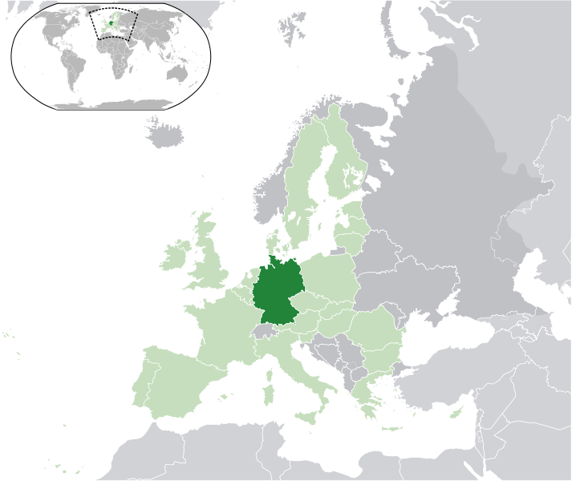
Introducing…
Region:
Europe
Capital City:
Berlin
Language:
German
Population:
81.7 million
Area:
137,846 square miles

Slide 21
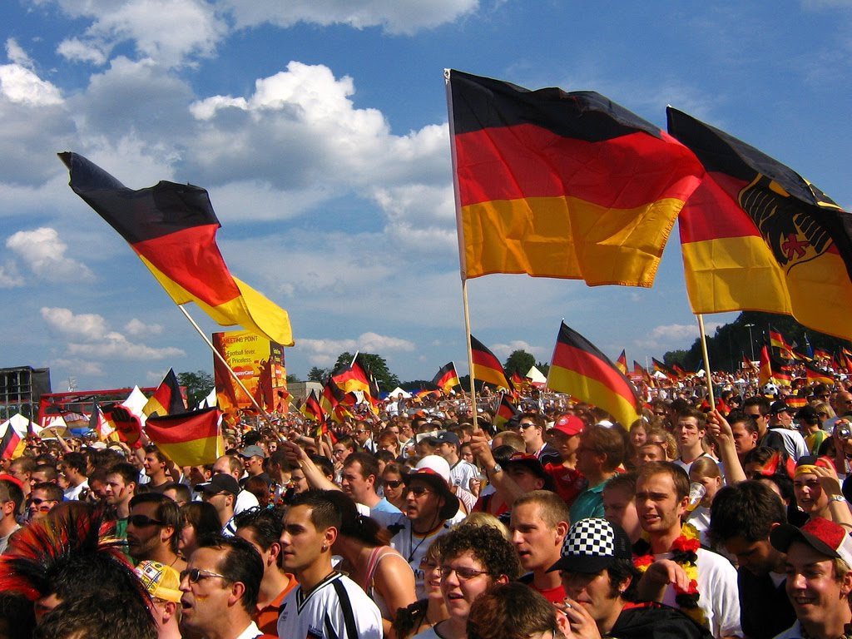
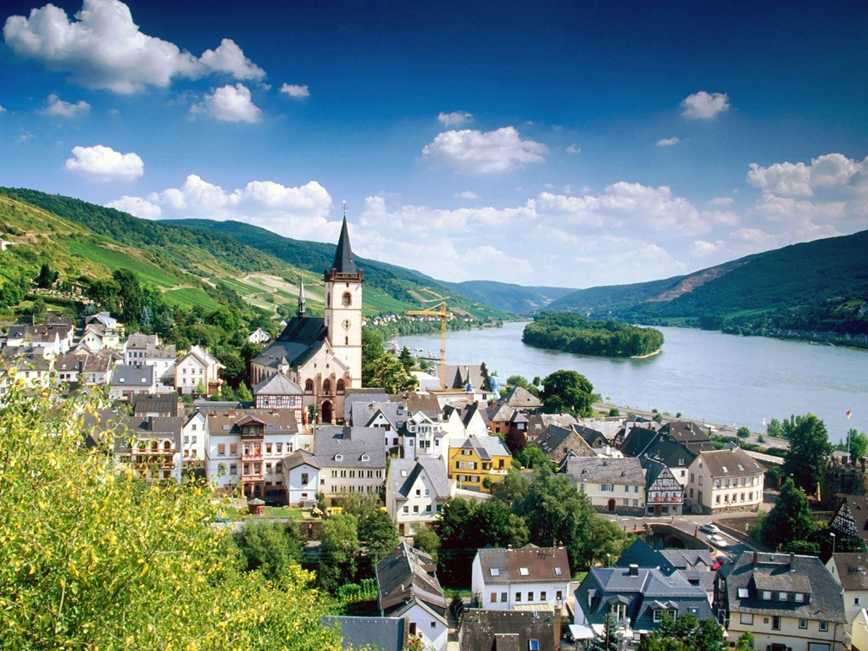
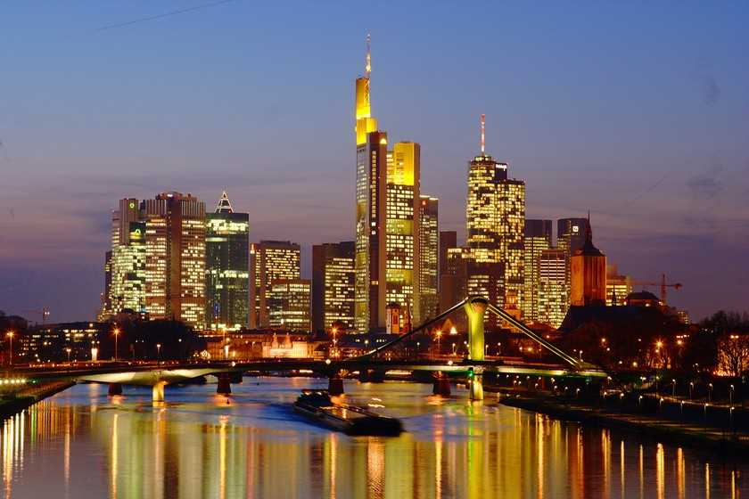
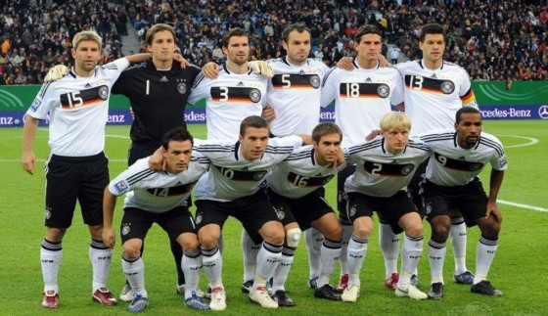
Germans showing their patriotism
A small town in Germany
The large city of Frankfurt
The German National Team (Soccer – they call it Football!)

Slide 22
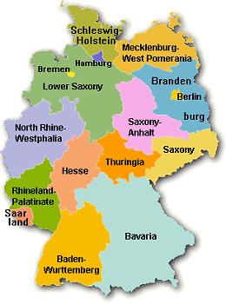
Germany
Germany is made up of many states, similar to the United States.

Slide 23

Germany
Also like the United States, Germany has a constitution.

Slide 24

COMPARE IT!
Freedom of Speech
The United States Constitution says:
“Congress shall make no law…abridging the freedom of speech…”
Germany’s Constitution says:
“Every person shall have the right freely to express and disseminate his opinions in speech, writing, and pictures and to inform himself without hindrance from generally accessible sources.”
“[This right] shall find [its] limits in the provisions of general laws, in provisions for the protection of young persons, and in the right to personal honor.”

Slide 25
COMPARE IT!
Freedom of the Press
The United States Constitution says:
“Congress shall make no law…abridging the freedom.. of the press…”
Germany’s Constitution says:
“Freedom of the press and freedom of reporting by means of broadcasts and films shall be guaranteed. There shall be no censorship.
[This right] shall find [its] limits in the provisions of general laws, in provisions for the protection of young persons, and in the right to personal honor.
Whoever abuses the freedom of expression, in particular the freedom of the press …in order to combat the free democratic basic order shall forfeit [this] basic right.”
Notes:
Germany’s constitution protects the press, but has limits when it comes to protecting youth and preserving “personal honor.” Freedom of the press is a right that can be forfeited in Germany.

Slide 26
COMPARE IT!
Freedom of Religion
The United States Constitution says:
“Congress shall make no law respecting an establishment of religion, or prohibiting the free exercise thereof…”
Germany’s Constitution says:
“Freedom of faith and of conscience, and freedom to profess a religious or philosophical creed, shall be inviolable. The undisturbed practice of religion shall be guaranteed.

Slide 27
COMPARE IT!
Equality Under the Law
The United States Constitution says:
“No State shall…deny to any person within its jurisdiction the equal protection of the laws.”
Germany’s Constitution says:
“All persons shall be equal before the law.”

Slide 28
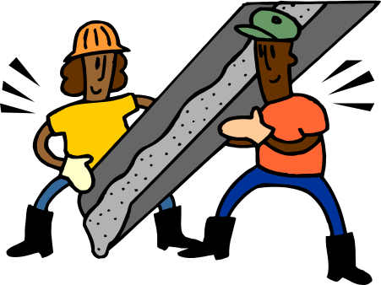
BUT WAIT!
Germany’s Constitution says:
“Men and women shall have equal rights. The state shall promote the actual implementation of equal rights for women and men and take steps to eliminate disadvantages that now exist.”
x
The United States Constitution says:
⇨
Should the United States amend its constitution to say what Germany’s constitution says?
Notes:
Teachers: Have students mark their ballots for or against this amendment.

Slide 29


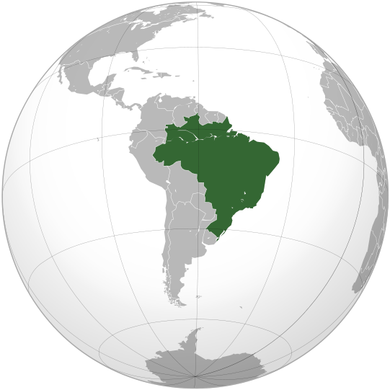
Introducing…
Region:
South America
Capital City:
Brasilia
Language:
Portugese
Population:
205 million
Area:
3.29 million sq miles

Slide 30
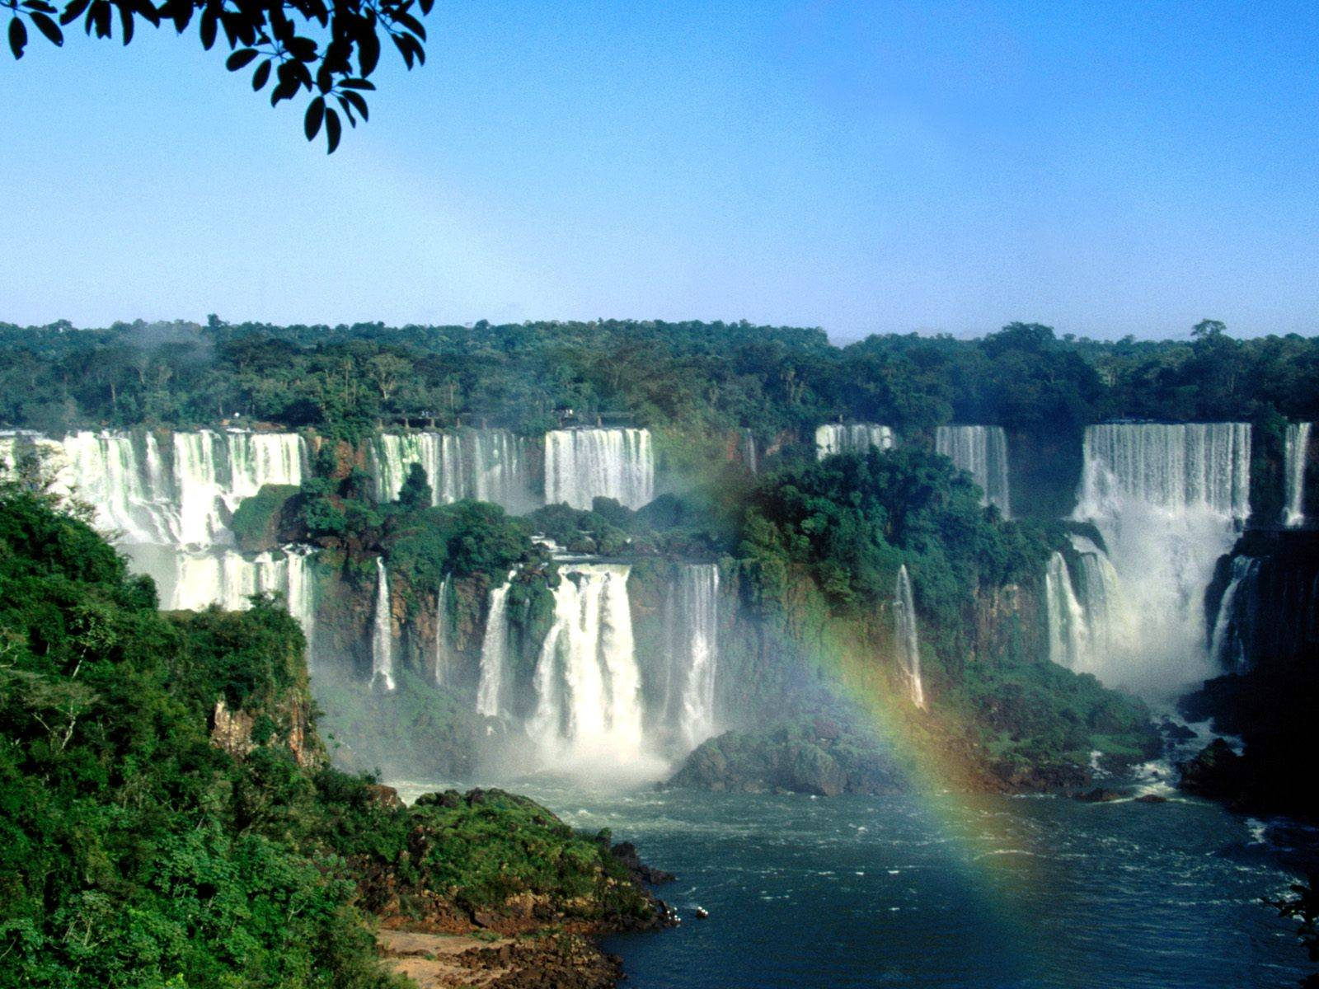

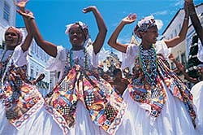
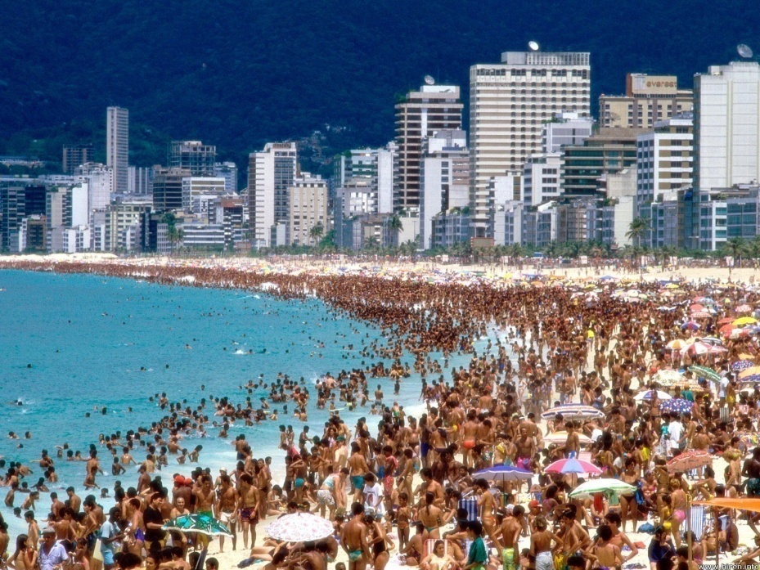
Brazilian Students
Iguazu Falls, Brazil
Traditional Brazilian dress
Rio de Janiero, Brazil

Slide 31
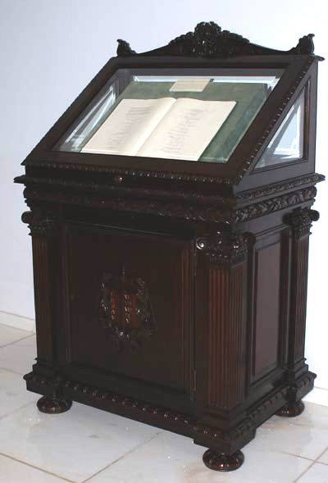
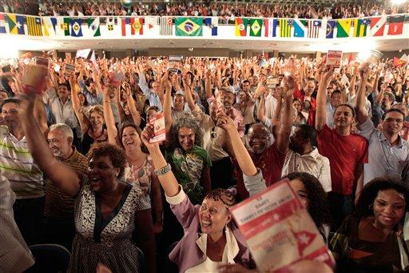
Brazil
One of these is to get rid of poverty and reduce social and regional inequalities.
Brazil’s constitution states that Brazil has four fundamental goals…
The Brazilian constitution
Citizens celebrate a win on election day

Slide 32

COMPARE IT!
Freedom of Speech
The United States Constitution says:
“Congress shall make no law…abridging the freedom of speech…”
Brazil’s Constitution says:
“…the expression of thought is free, anonymity being forbidden…”
Notes:
“Anonymity being forbidden” means that you have the right to freedom of speech as long as you don’t remain anonymous!

Slide 33
COMPARE IT!
Freedom of the Press
The United States Constitution says:
“Congress shall make no law…abridging the freedom.. of the press…”
Brazil’s Constitution says:
“…the expression of thought is free, anonymity being forbidden…”
⇨
Like in India, there is no separate “freedom of the press” in Brazil’s constitution.
⇨
“Freedom of speech” works double duty!

Slide 34
COMPARE IT!
Freedom of Religion
The United States Constitution says:
“Congress shall make no law respecting an establishment of religion, or prohibiting the free exercise thereof…”
Brazil’s Constitution says:
“Freedom of conscience and of belief is inviolable, the free exercise of religious cults being ensured and, under the terms of the law, the protection of places of worship and their rites being guaranteed…”

Slide 35
COMPARE IT!
Equality Under the Law
The United States Constitution says:
“No State shall…deny to any person within its jurisdiction the equal protection of the laws.”
Brazil’s Constitution says:
“All persons are equal before the law, without any distinction whatsoever…”

Slide 36

BUT WAIT!
Brazil’s Constitution says:
“Electoral enrollment and voting are mandatory for persons over eighteen years of age [and] optional for: a) the illiterate; b) those over seventy years of age; c) those over sixteen and under eighteen years of age.”
The United States Constitution says:
“The right of citizens of the United States, who are eighteen years of age or older, to vote shall not be denied or abridged…”
⇨
Should the United States amend its constitution to say what Brazil’s constitution says?
Notes:
Teachers: Have students mark their ballots for or against this amendment.

Slide 37


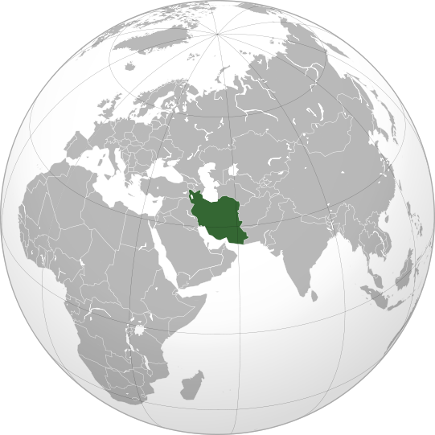
Introducing…
Region:
Middle East
Capital City:
Tehran
Language:
Persian & Turkic
Population:
78.9 million
Area:
636,372 sq miles

Slide 38
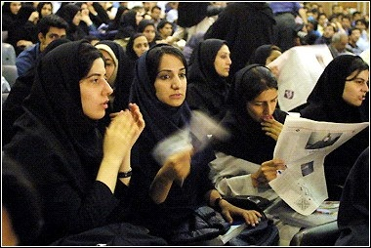
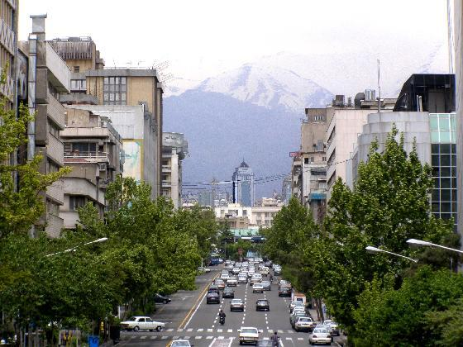
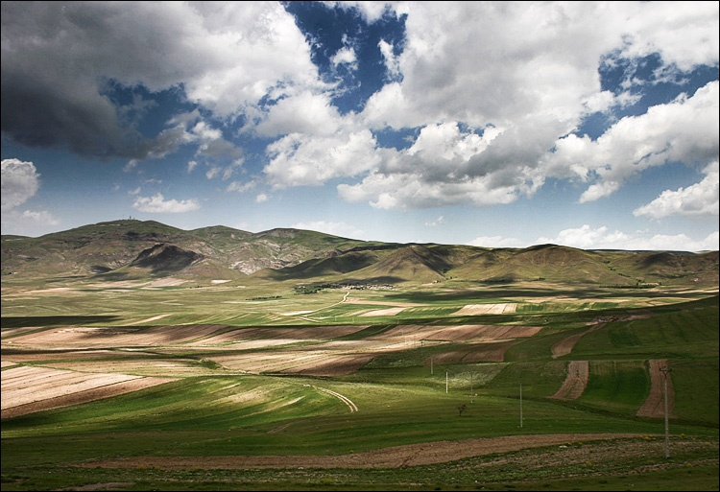
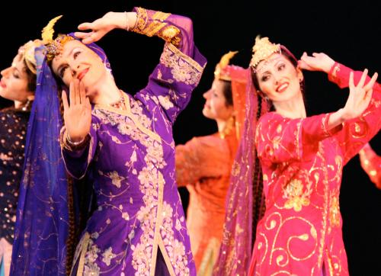
Iranian Students
In the capital, Tehran
Northern Iran
Traditional Persian costumes

Slide 39
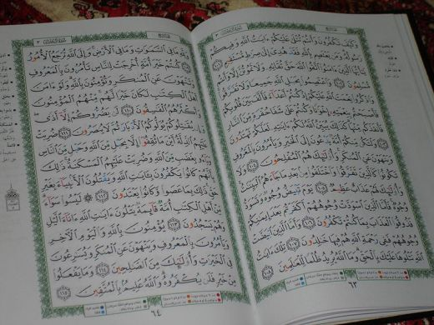
Iran
Iran’s constitution states that the Qur’an, or holy book of Islam, is the center of rule in Iran.

Slide 40
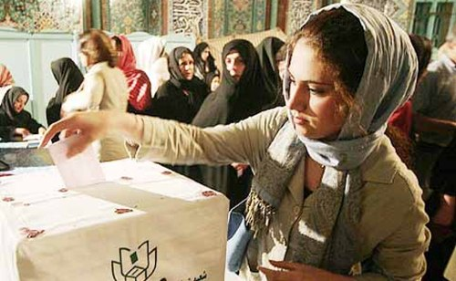
Iran
Iranians have the right to vote, just like we do here in the United States.

Slide 41
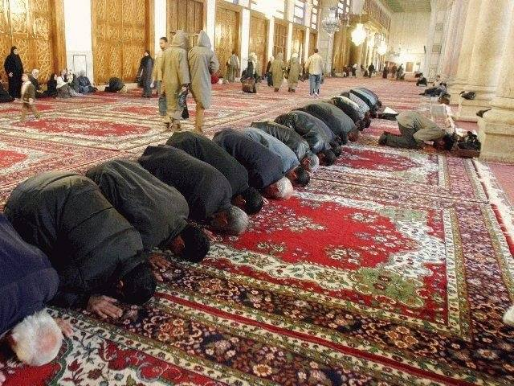
Iran
These values include things like wearing modest clothes, not drinking alcohol, and observing other religious rules.
Iran’s constitution gives citizens the responsibility to promote the values of the Islamic faith.

Slide 42

COMPARE IT!
Freedom of Speech
The United States Constitution says:
“Congress shall make no law…abridging the freedom of speech…”
Iran’s Constitution says:
⇨
Iran’s constitution does not say anything about individual people having freedom of speech
⇨
“Freedom of the press” must do double-duty…

Slide 43
COMPARE IT!
Freedom of the Press
The United States Constitution says:
“Congress shall make no law…abridging the freedom.. of the press…”
Iran’s Constitution says:
“Publications and the press have freedom of expression except when it is where there is infringement of the basic tenets of Islam or public rights. In this respect detailed provisions will be laid down by law.”

Slide 44
COMPARE IT!
Freedom of Religion
The United States Constitution says:
“Congress shall make no law respecting an establishment of religion, or prohibiting the free exercise thereof…”
Iran’s Constitution says:
“The official religion of Iran is Islam … and this principle will remain eternally immutable.”
“Zoroastrian, Jewish, and Christian Iranians are the only recognized religious minorities, who, within the limits of the law, are free to perform their religious rites and ceremonies…”

Slide 45
COMPARE IT!
Equality Under the Law
The United States Constitution says:
“No State shall…deny to any person within its jurisdiction the equal protection of the laws.”
Iran’s Constitution says:
“All citizens of the country, both men and women, equally enjoy the protection of the law…”

Slide 46

BUT WAIT!
Iran’s Constitution says:
“The preservation of the environment … is regarded as a public duty in the Islamic Republic. Economic and other activities that inevitably involve pollution of the environment or cause irreparable damage to it are therefore forbidden.”
x
The United States Constitution says:
⇨
Should the United States amend its constitution to say what Iran’s constitution says?
Notes:
Teachers: Have students mark their ballots for or against this amendment.

Slide 47


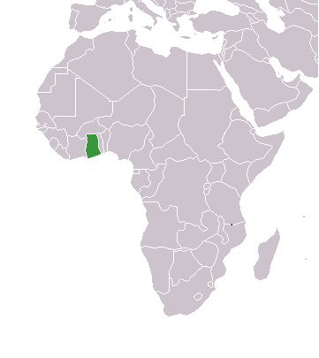
Introducing…
Region:
Africa
Capital City:
Accra
Language:
English & Akan
Population:
27 million
Area:
92,098 square miles

Slide 48
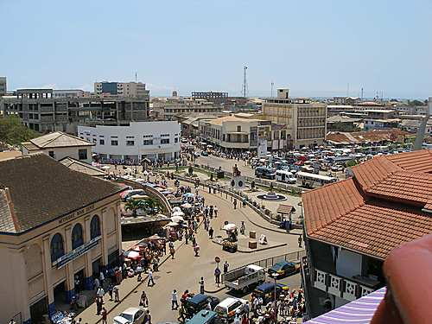
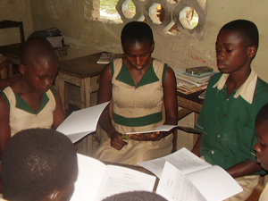
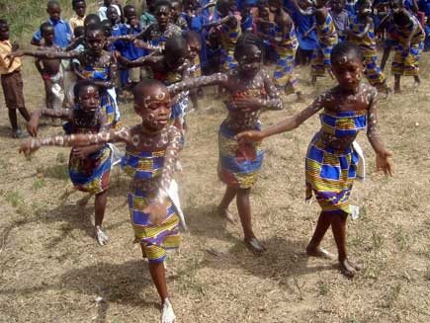
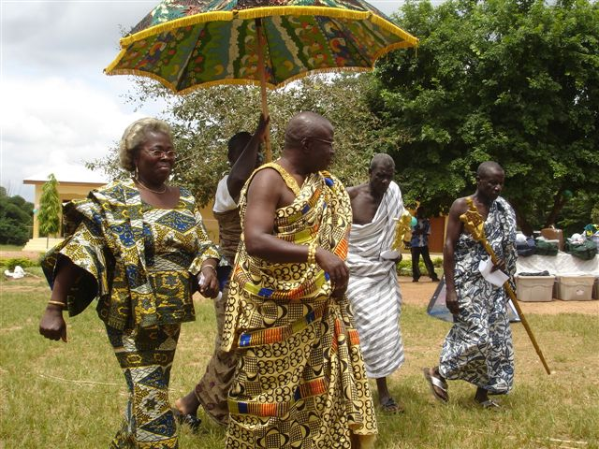
Capital of Accra
Ghanaian Students
Children perform traditional dance
Elders in traditional Ghanaian dress

Slide 49
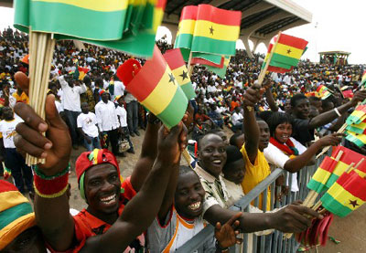
Ghana
Ghana was the first African country south of the Sahara desert to gain its freedom.
Celebrating Ghanaian
Independence Day on March 6th!

Slide 50

COMPARE IT!
Freedom of Speech
The United States Constitution says:
“Congress shall make no law…abridging the freedom of speech…”
Ghana’s Constitution says:
“All persons shall have the right to…freedom of speech and expression…
[But the government may pass laws that are] reasonably required for the purpose of safeguarding the people of Ghana against the teaching … of a doctrine which … encourages disrespect for the nationhood of Ghana, the national symbols and emblems, or incites hatred against other members of the community …

Slide 51
COMPARE IT!
Freedom of the Press
The United States Constitution says:
“Congress shall make no law…abridging the freedom.. of the press…”
Ghana’s Constitution says:
“All persons shall have the right to freedom of speech and expression, which shall include freedom of the press and other media…”
⇨
The same restrictions for freedom of speech also apply to freedom of the press

Slide 52
COMPARE IT!
Freedom of Religion
The United States Constitution says:
“Congress shall make no law respecting an establishment of religion, or prohibiting the free exercise thereof…”
Ghana’s Constitution says:
“All persons shall have the right to freedom to practice any religion and to manifest such practice…”

Slide 53
COMPARE IT!
Equality Under the Law
The United States Constitution says:
“No State shall…deny to any person within its jurisdiction the equal protection of the laws.”
Ghana’s Constitution says:
“All persons shall be equal before the law .”

Slide 54
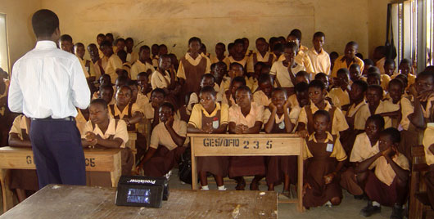
BUT WAIT!
Ghana’s Constitution says:
“All persons shall have the right to equal educational opportunities and facilities and … basic education shall be free, compulsory and available to all.”
x
The United States Constitution says:
⇨
Should the United States amend its constitution to say what Ghana’s constitution says?
Notes:
Teachers: Have students mark their ballots for or against this amendment.

Slide 55
Requirement 3a
Pick a current world event. In relation to this current event, discuss with your counselor how a country's national interest and its relationship with other countries might affect areas such as its security, its economy, its values, and the health of its citizens.

Slide 56
Requirement 3b
Select a foreign country and discuss with your counselor how its geography, natural resources, and climate influence its economy and its global partnerships with other countries

Slide 57
4a. International Law
National law is how a country deals with issues within its borders.
International law is the rules and principles which govern the relations and dealings of nations with each other.
  Difficult to form & enforce
  Coordinates trade
  Solve problems and resolve disputes
    World Court
    United Nations

Slide 58
International Law
Two legal theories:
  Monist: proposes to unify national and international laws
  Dualist: National and International legal systems are separate and different.
“Peace, commerce, and honest friendship with all nations – entangling alliances with none.” – Thomas Jefferson

Slide 59
International Law & Conflict Resolution
International Law identifies how a country will deal with nuclear threats, destruction of the environment, terrorism, trade imbalances, famine and disease control. Countries will not jeopardize their relationship with the United States if they know how we will deal with a particular conflict.

Slide 60
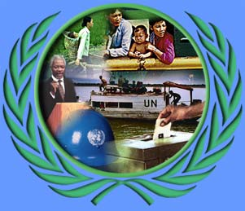
4C #1. United Nations
Goals
  Maintain International Peace and Security
  Promote Cooperation in Solving International Problems:
    Political
    Economic
    Social
    Cultural, and
    Humanitarian

Slide 61
UN Structure
UN
General Assembly
All Nations
Debates
Security Council
Economic and Social Council
Trusteeship Council
Int’l Court of Justice
Secretariat
15 Members
5 Permanent
Peacekeeping
WHO
IMF
ITU
WTO
UNICEF
etc
15 Judges
The Hague
Administration

Slide 62
The Scourge of War Since 1945
Wikipedia lists 181 wars since 1945
Around 35 million People Dead
  War estimates are difficult
  37 million in WW I
  50-70 million in WW II

Slide 63
UN Key Objectives for the 21st Century
Promote the Creation of Independent and Democratic Societies
Protecting Human Rights
Saving Children from Starvation and Disease
Providing Relief assistance to Refugees and Disaster Victims
Counter Global Crime, Drugs, and Disease
Assisting Countries devastated by war and the long-term threat of land mines

Slide 64
Promote the Creation of Independent and Democratic Societies

Slide 65
Protecting Human Rights
Successes
  Highlights human-rights abuses around the world.
  Applies pressure for reform.
Failures
  Libya was elected to head the commission in 2003
  Sudan was elected to head the commission in 2004
  Some commission members have miserable human-rights records: China, Cuba, Zimbabwe, Russia, Saudi Arabia, Pakistan, Algeria, Syria, Libya, and Vietnam.
Most Complaints Against: Canada, Korea, then Australia
Notes:
Current state party to the ICCPR having the highest number of registered complaints directed against them: Canada (158). Second highest number: Republic of Korea (125). Third highest number: Australia (124) .
2011 - 116 complaints
2010 - 72 complaints
2009 - 88 complaints
2008 - 225 complaints
2007 - 87 complaints
2006 - 71 complaints
2005 - 112 complaints
2004 - 103 complaints
2003 - 92 complaints
2002 – 103 complaints

Slide 66
UN Humanitarian Assistance
Successes
  Works with other relief organizations, such as the Red Cross
  Provides food, water, shelter to missions displaced by war, famine, or natural disasters.
  World Food Program (serves 110 million people in 80 countries)
  High Commissioner for Refugees (projects 116 countries)
Failures
  Oil-For-Food Program
  Human Rights abuse by UN Peacekeepers

Slide 67
Saving Children from Starvation & Disease
UNICEF &World Health Organization
  Childhood vaccines
  Smallpox & Polio almost eradicated
  Measles
  Water, Sanitation and Hygiene
  HIV/AIDS
  Nutrition

Slide 68

World Organization of the
Scout Movement
28 Millions Scouts
216 Countries
World Scout Jamboree
Promote scouting world wide
BP: "The roots of Scouting have grown among young people of all civilized countries and are developing more each day. It might be thought that if in years to come, a considerable proportion of the future citizens of each nation forms part of this brotherhood, they will be joined by a bond of personal friendship and mutual understanding such as has never existed before, which will help to find a solution to terrible international conflicts."

Slide 69
5a. Constitutional vs Nonconstitutional
Written Constitution?
Authoritarian
Democratic Republic?
  North Korea
Unitary Gov’t
Written Constitution
Protects Individual Rights
Limited Gov’t Power
  Checks & Balances
Stability
Federal Gov’t

Slide 70

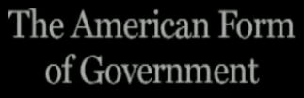
5b. Different Types of Gov’t
I highly recommend you show this video. You can watch on YouTube or buy the video and show the excerpt.

Slide 71
5c. Mapping Government Types
Should be easy!
Let’s Look at Venezuela
Founded in 1830 under Military Rule.
1958 Civilian Rule. 1961 Constitution.
1992 failed coup d'état by Chávez
1998 Chávez won election with 56%
1999 New Constitution with 6 year Presidential term (limited to 2)
2007 Amended Constitution Rejected
2007 State took over the TV(Chávez’ candidates get free ads)
2008 Over 300 Opposition Candidates disqualified
2009 Referendum to eliminate term limits passed
Is it a Republic? An Oligarchy? A Dictatorship?

Slide 72
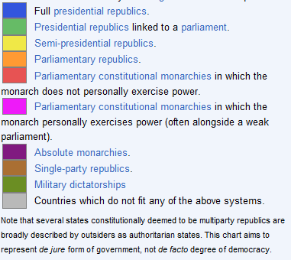
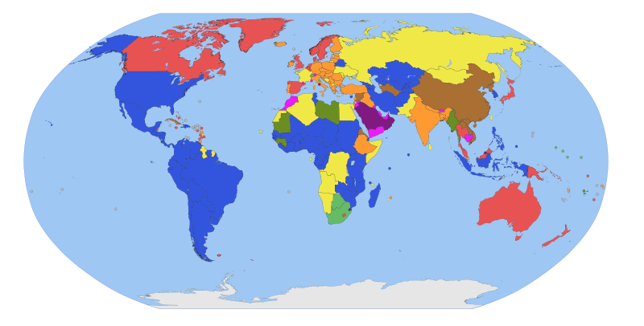
5c. Governments from wikipedia

Slide 73
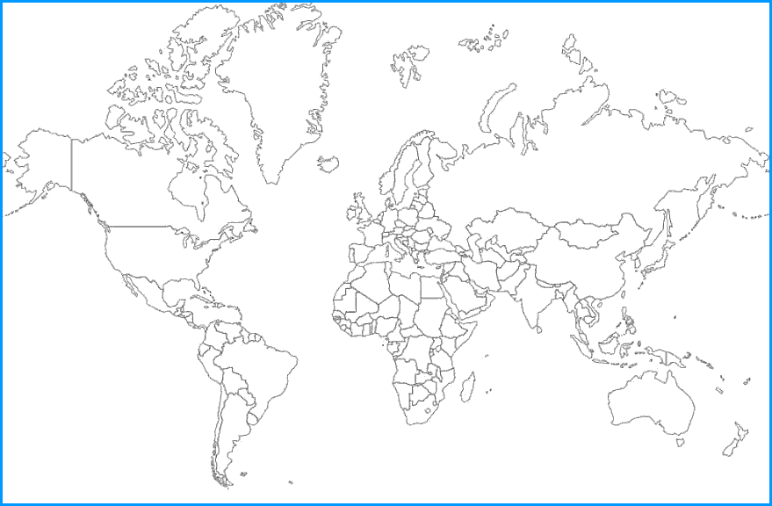

Slide 74
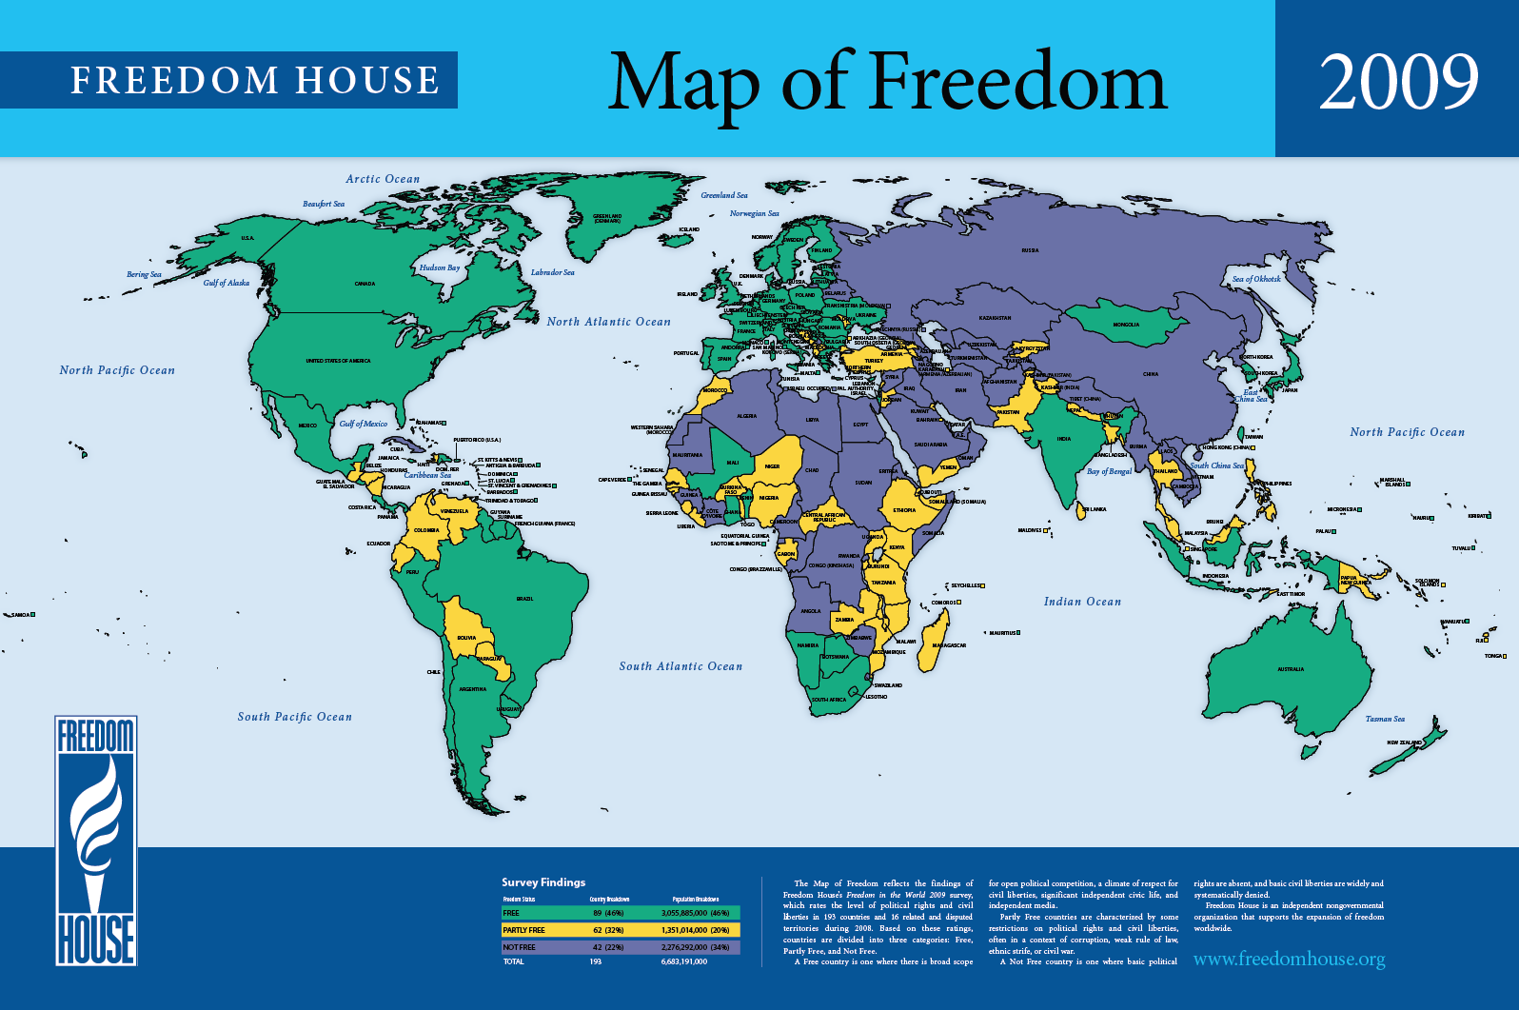

Slide 75
6a. Gov’t Representation Abroad
Who represents the US Government?
How is the United States government accredited to international organizations?

Slide 76
6b. Roles
Ambassador
Consul
Bureau of Int’l Information Programs
Agency for Int’l Development
US and Foreign Commercial Service

Slide 77
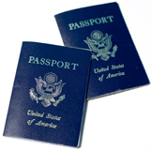
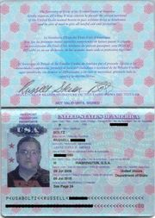
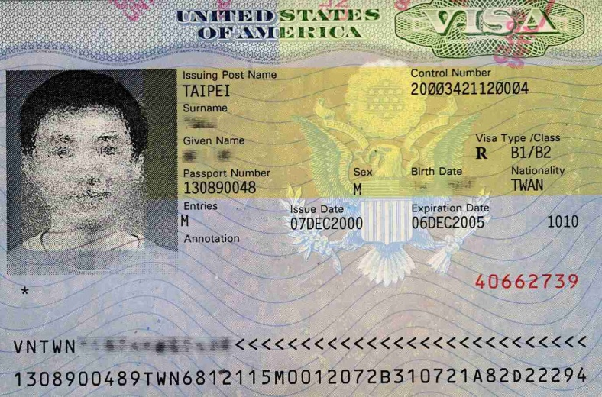
6c. Passport & Visa
6c. Explain the purpose of a passport and visa for int’l travel.
US Passports
Visa

Slide 78
7.Do Two
a. Visit the Web site of the U.S. State Department. Learn more about an issue you find interesting that is discussed on this Web site.
b. Visit the Web site of an international news organization or foreign government, OR examine a foreign newspaper available at your local library, bookstore, or newsstand. Find a news story about a human right realized in the United States that is not recognized in another country.

Slide 79
7.Do Two
c. Visit with a student or Scout from another country and discuss the typical values, holidays, ethnic foods, and traditions practiced or enjoyed there.
d. Attend a world Scout jamboree.
e. Participate in or attend an international event in your area, such as an ethnic festival, concert, or play.

Slide 80
The End

